Slide 1
Digital Portfolio
STUDENT NAME: Mohammed Ashik H
REGISTER NO: 2426J0494
NMID: 90EB8D9EA51B5108DF344DC3E82F993F
DEPARTMENT: Information Technology
COLLEGE: Sri Krishna Adithya College of Arts and Science /
Bharathiyar University

Slide 2
PROJECT TITLE
Simple calculator portfolio using Frontend Web Development

Slide 3

AGENDA
Problem Statement
Project Overview
End Users
Tools and Technologies
Portfolio design and Layout
Features and Functionality
Results and Screenshots
Conclusion
Github Link

Slide 4

PROBLEM STATEMENT
Most student portfolio websites are limited to presenting personal details, academic achievements, and project work in a static format, which fails to fully engage viewers or demonstrate practical technical skills.
There is a lack of interactivity and creative features that can make a portfolio stand out.
Users often need a simple tool to perform quick arithmetic operations like addition, subtraction, multiplication, and division.
Physical calculators or complex apps may be unnecessary for such tasks.
This project aims to build a simple, responsive, and user-friendly calculator using HTML, CSS, and JavaScript, showcasing fundamental frontend web development skills while solving a real-world need.

Slide 5
PROJECT OVERVIEW
The Simple Calculator is a web-based application developed using HTML, CSS, and JavaScript to perform basic arithmetic operations such as addition, subtraction, multiplication, and division.
The project focuses on creating a clean, responsive, and user-friendly interface that allows users to calculate quickly and efficiently. As a frontend web development portfolio project, it demonstrates fundamental skills in structuring content with HTML, styling with CSS, and adding interactivity with JavaScript.
The calculator serves as both a practical utility tool and a showcase of core development concepts like DOM manipulation, event handling, and responsive design.

Slide 6

WHO ARE THE END USERS?
Students (Portfolio Owners) – create and manage their portfolio and restaurant menu page.
Recruiters / Employers – view student’s skills, projects, and assess
technical abilities.
Teachers / Mentors – evaluate the portfolio as part of academic
assessment.
Peers / Classmates – explore the portfolio and engage with simple calculator.
General Audience / Visitors – browse the website for both portfolio
and simple calculator content.

Slide 7
TOOLS AND TECHNIQUES
HTML5 → For creating the structure of the calculator (buttons, input/output display).
CSS3 → For styling the calculator with colors, layouts, and responsive design.
JavaScript (ES6) → For implementing logic, handling button clicks, and performing calculations.
DOM Manipulation → To dynamically update the calculator’s display based on user input.
Event Handling → To capture button clicks and trigger calculations.
Responsive Design → Using CSS (flexbox/grid) to ensure the calculator works across devices.

Slide 8
POTFOLIO DESIGN AND LAYOUT
Homepage – Student’s name, photo, tagline, and
navigation bar.
About Me – Profile picture with short bio, education, and goals.
Skills Section – Skills shown using progress bars, icons, or charts.
Projects Section – Grid/cards with project title,
description, tech stack, and links.

Slide 9
Simple Calculator –The Simple Calculator Portfolio is designed with a minimal, clean, and user-friendly layout to highlight both functionality and frontend development skills. The design ensures clarity, responsiveness, and ease of use.
Contact Section – Contact form, social media links, and footer.
Design Principles – Responsive layout, consistentcolors, clear fonts, proper spacing, and smooth animations.

Slide 10
FEATURES AND FUNCTIONALITY
Basic Arithmetic Operations → Supports addition, subtraction, multiplication, and division.
Clear/Reset Button → Allows users to clear the display and start fresh.
Responsive Design → Works smoothly on desktops, tablets, and mobile devices.
Interactive Buttons → Well-styled buttons with hover and click effects for better user experience.
Error Handling → Handles invalid inputs such as division by zero gracefully.

Slide 11
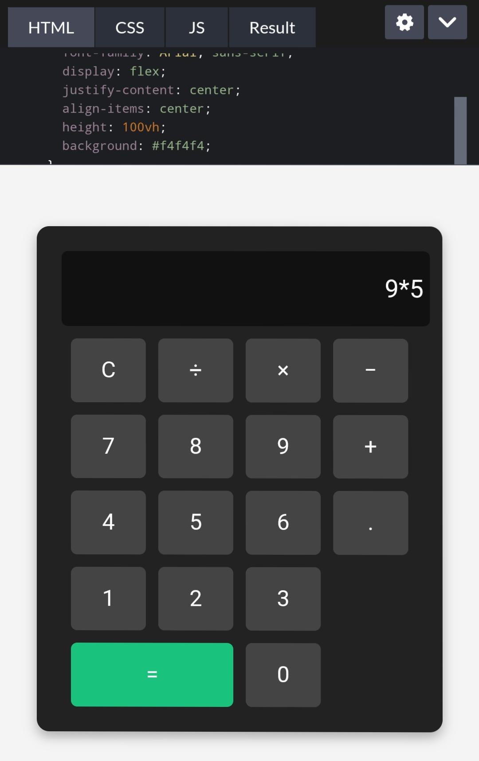
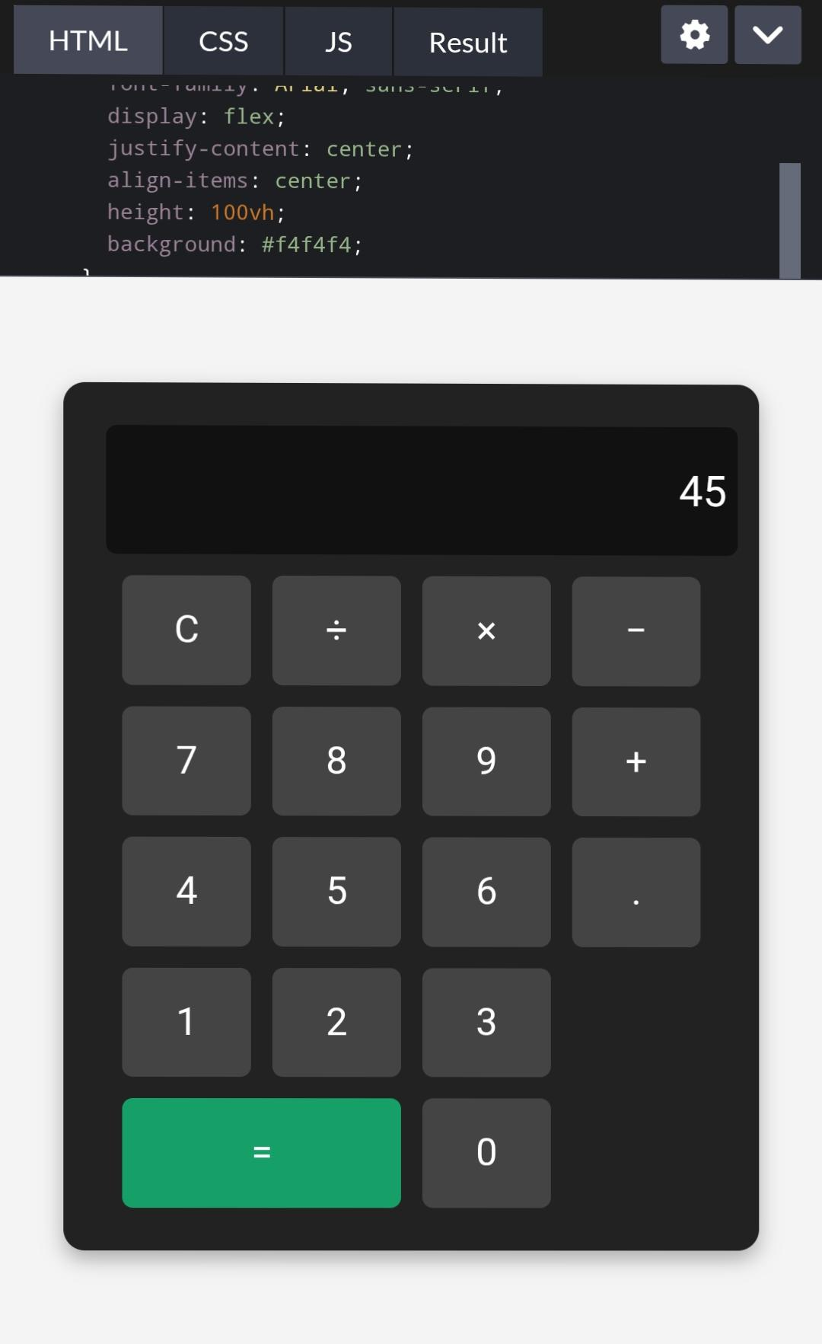
RESULTS AND SCREENSHOTS
Homepage with profile picture
11

Slide 12
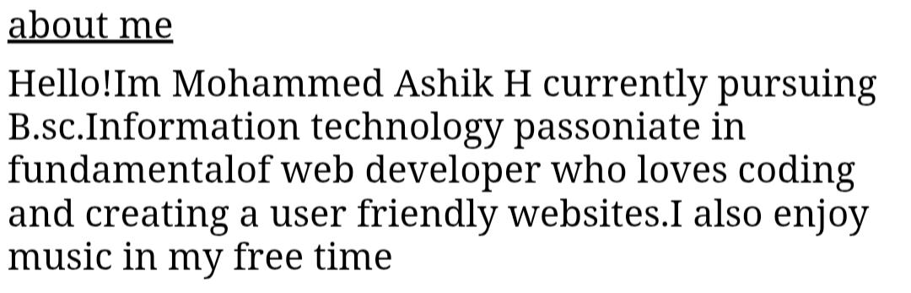
About Section

Slide 13
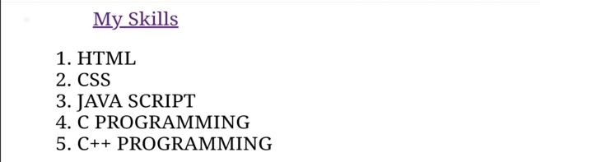
Skills Section

Slide 14
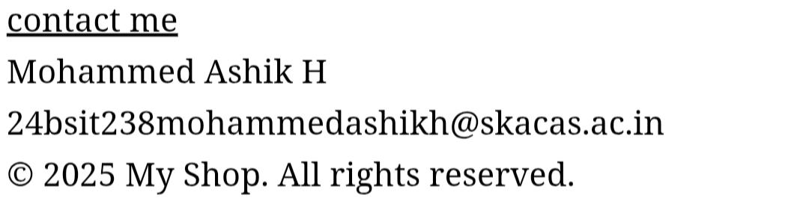
Contact Form

Slide 15
CONCLUSION
The Simple Calculator Project demonstrates the effective use of frontend web development technologies—HTML, CSS, and JavaScript—to build a practical and interactive application. By developing this calculator, core skills such as structuring content, applying responsive design, and implementing dynamic functionality were successfully applied . This project not only provides a useful tool for performing basic arithmetic operations but also serves as a strong addition to a developer’s portfolio, showcasing problem-solving ability, coding knowledge, and design skills. It highlights how even a simple project can combine creativity and functionality to deliver a user-friendly digital solution.
15

Slide 16
Github Link
https://github.com/24bsit238mohammedashikh-sys/TNSDC-FWD-DIGITAL-PORTFOLIO.git

